Slide 1

Advanced🤓Console Applications in GO
Not that advanced as you will see…

Slide 2
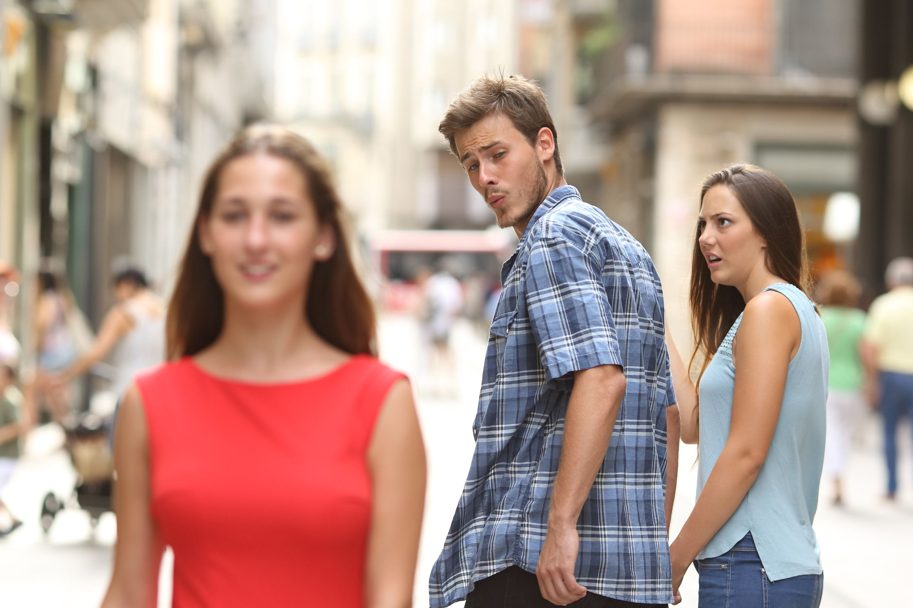
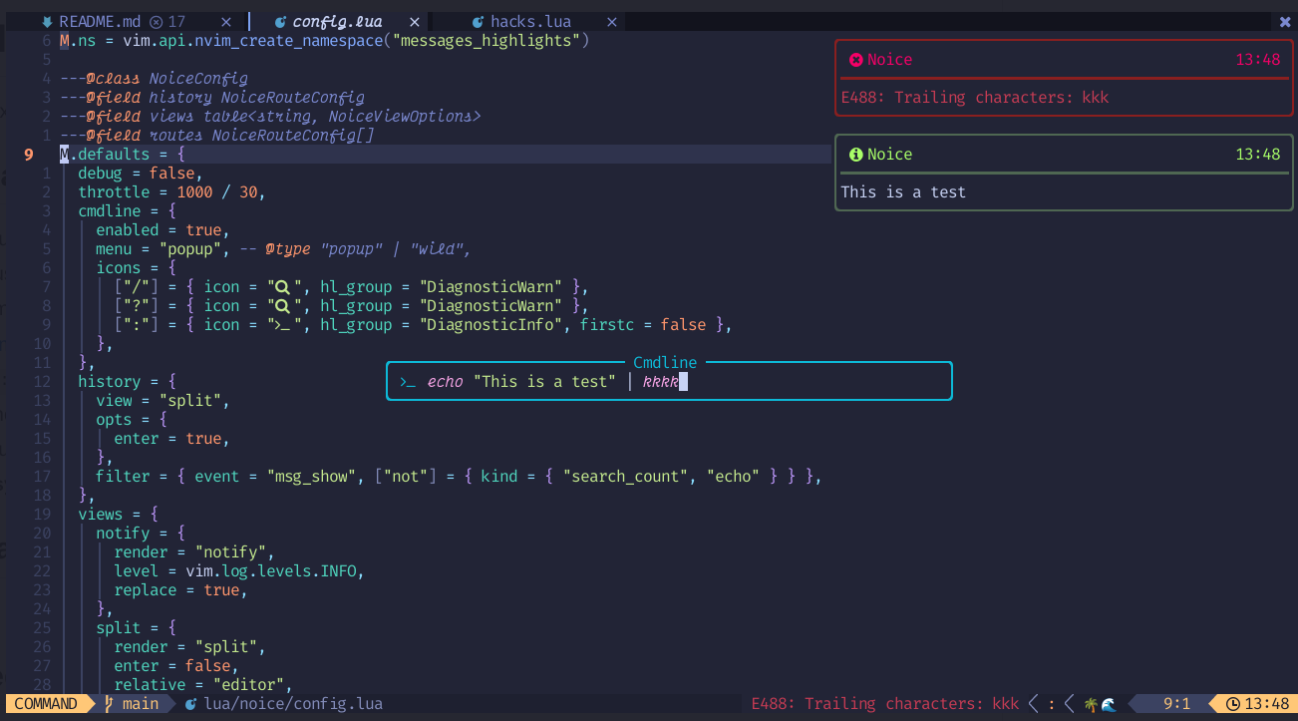
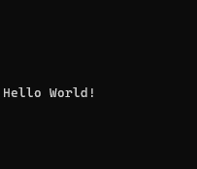

Ever wonder why your console apps suck?
You

Slide 3
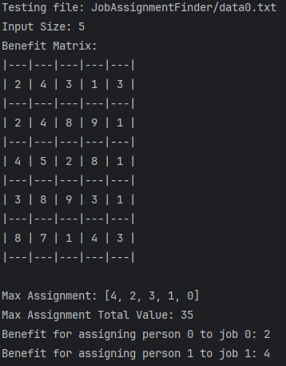
Me too. Remember when we had to do this?
COMP3760 – Lab 1

Slide 4
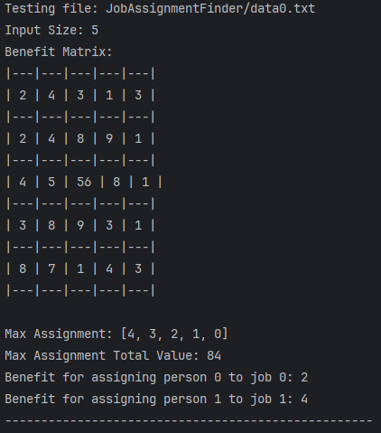

But then this…
ITS NOT ALIGNED

Slide 5
What are the main challenges of making good terminal apps?

Slide 6
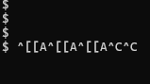
Input is hard
Did anyone else run into this in their custom shell in OS?
(Multiple “up arrow” attempts follow by two “exit” attempts)

Slide 7
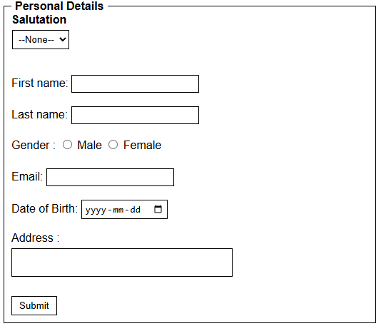
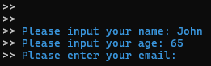
Just text input can only go so far…
It would be nice if we could allow for other kinds of inputs, like:
checkboxes,
text areas,
dropdowns, or
buttons!
>

Slide 8

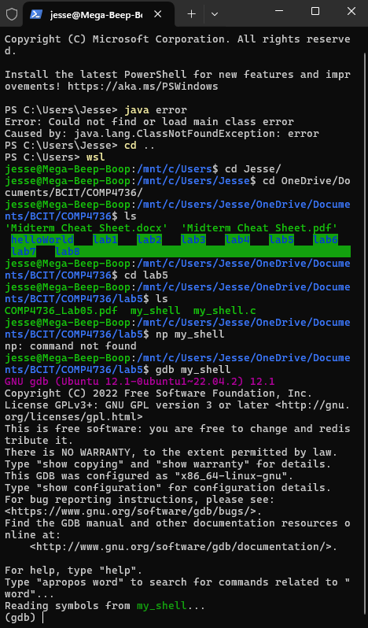
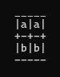
Displaying columns is hard
Rendering rows is not so bad, the terminal goes line by line. Columns are a different beast. There is so much to consider:
Remember this nonsense?
Variable width data
Handling small terminal widths (does this look familiar?)
My best attempt at a grid (gross)
Vertical lines

Slide 9
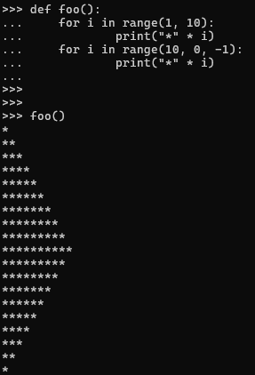

Graphics are hard
Case in point, these are the prettiest thing I’ve made in the terminal:
It’s supposed to be a normal dog. Not a skeleton looking dog…
His name is Askey 👀

Slide 10
Terminals must be saved! But by who?

Slide 11


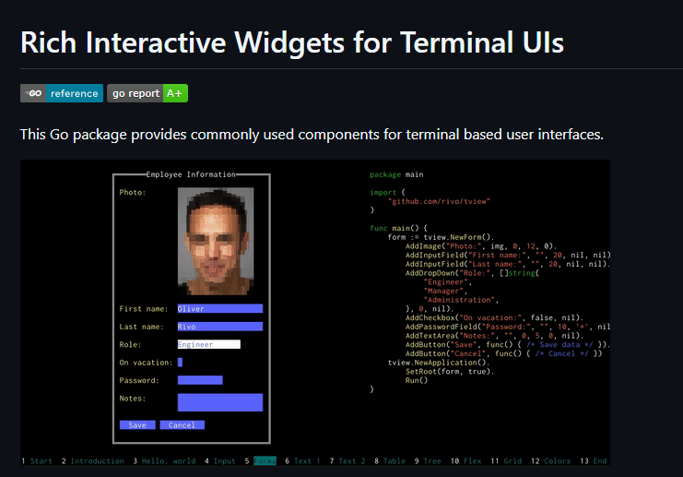
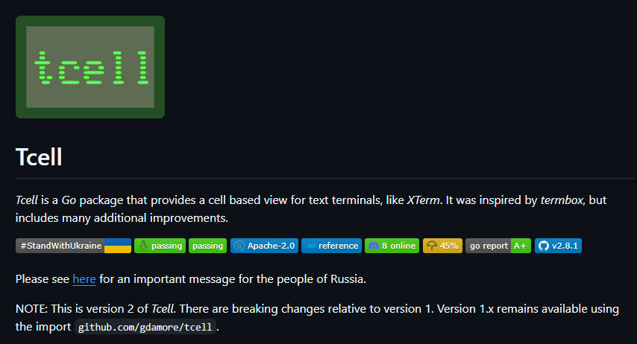
Big thanks to rivo && gdamore
https://github.com/rivo
https://github.com/gdamore

Slide 12
Can tview solve our problems?
Yes! But not by me, it was too hard to do gud… (demo later)
Here’s how! (All future screenshots are of tview running in the terminal)

Slide 13
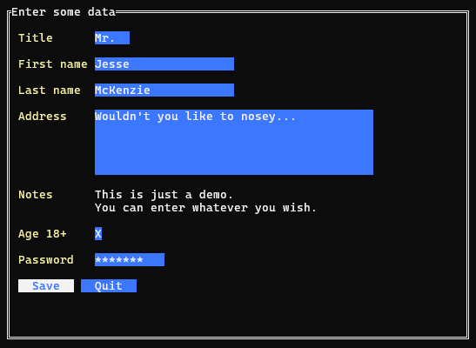
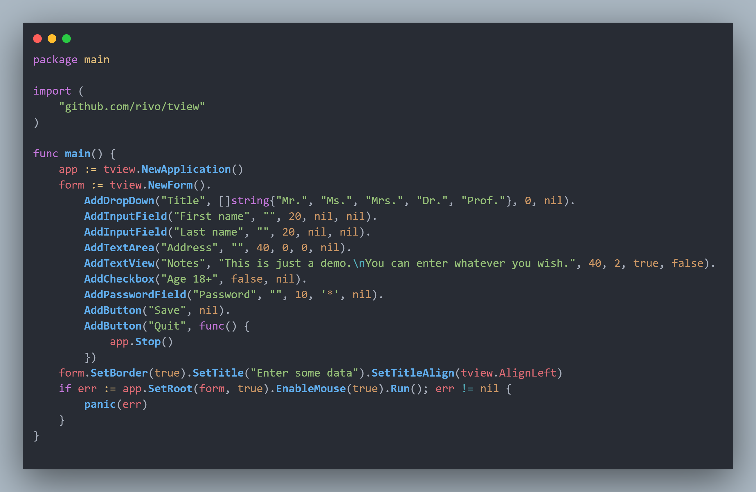
Solving input
This form is fully interactable via tabbing through

Slide 14
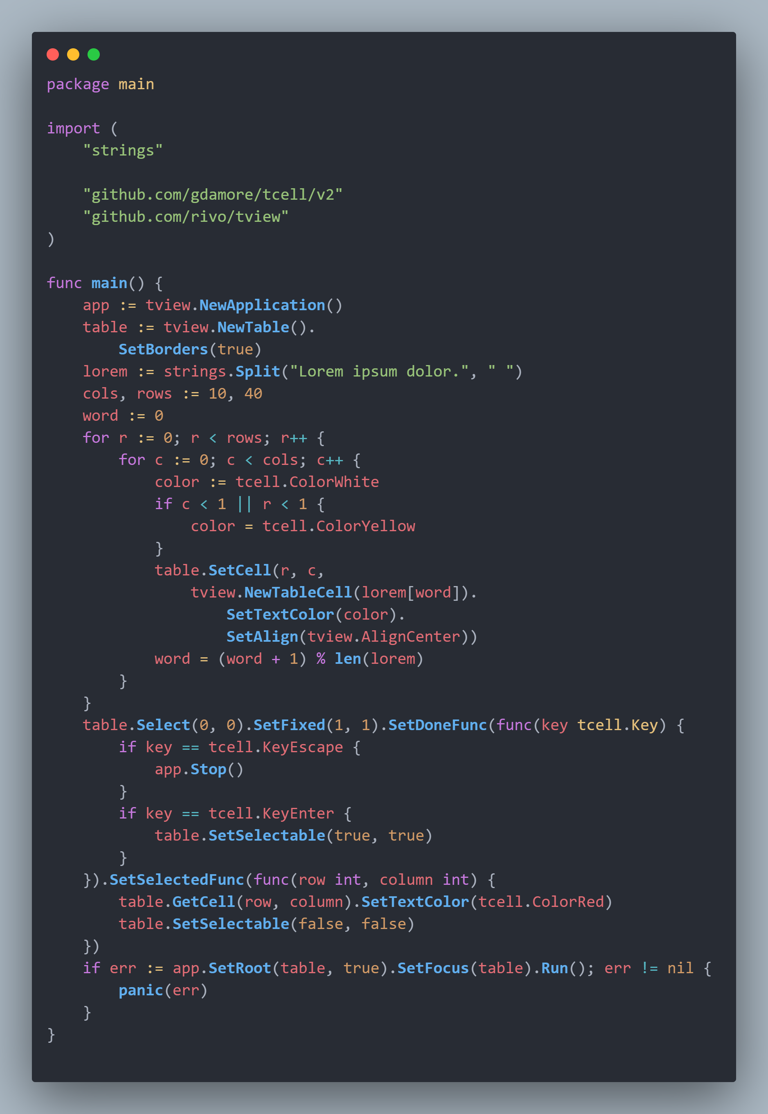
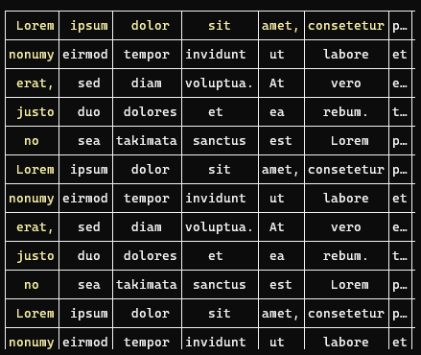
Solving columns
Content-aware width!
Automatic ellipses! 😲

Slide 15
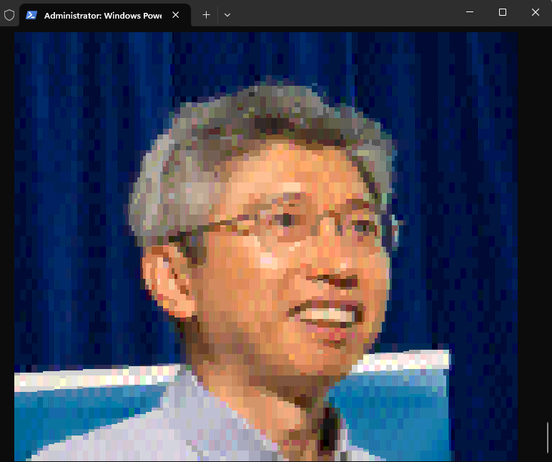
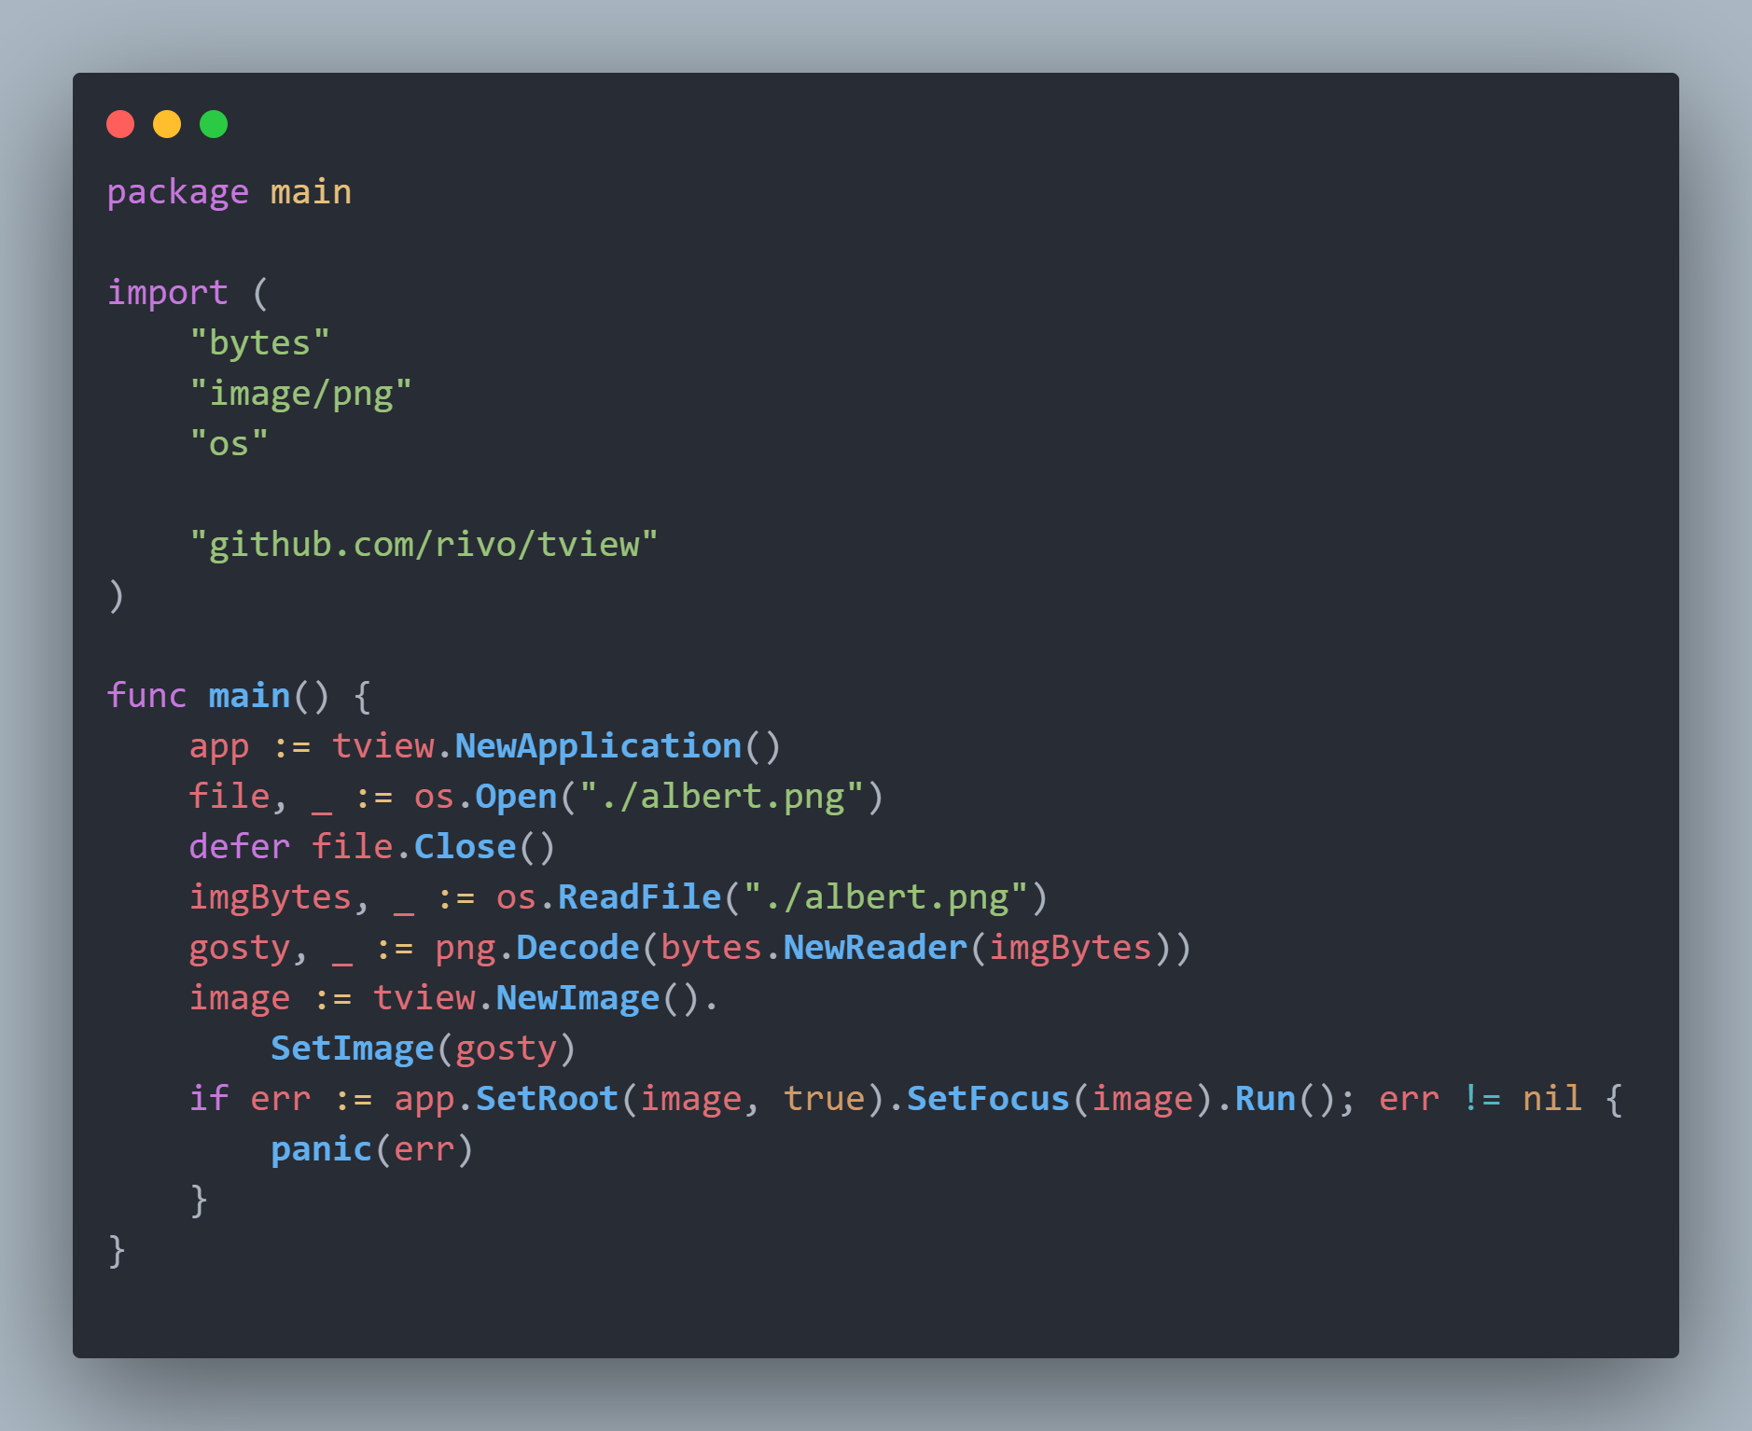
Solving graphics
Nuff said

Slide 16

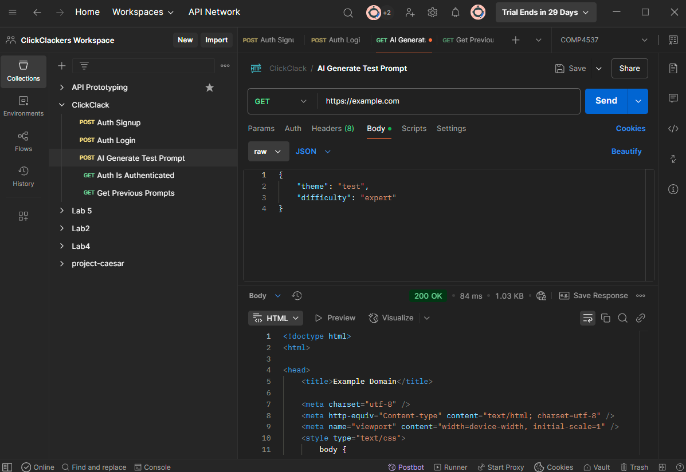
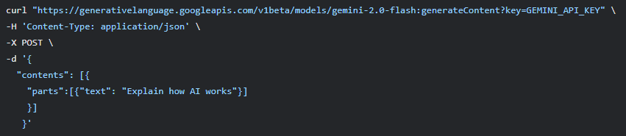


My Project
Basically, Postman is awesome, and terminals are awesome, but currently the intersection of those two suck right now.
cURL 🤮
>

Slide 17
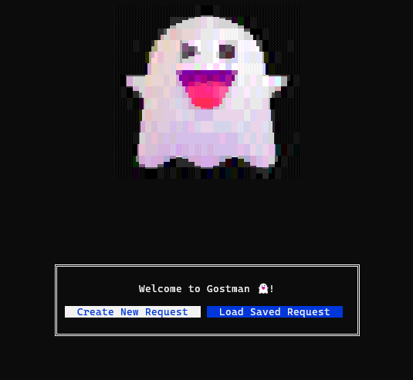
Introducing gostman!

Slide 18
Live Demo (hope it works)

Slide 19
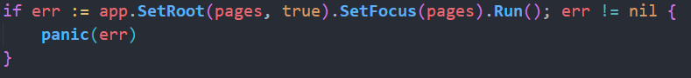
Let’s explain the code:
The 4 main screens (home screen, make request, load request, execute request) are all of type tview.Page
Entry point ^

Slide 20
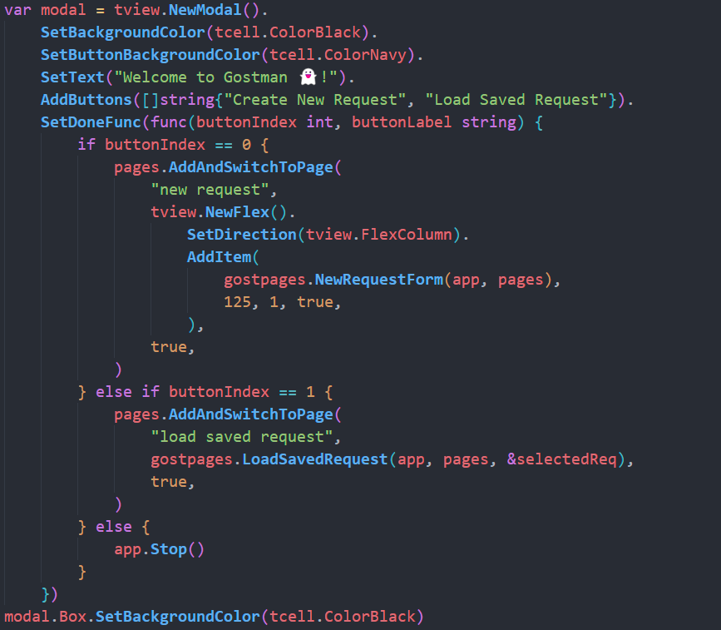
Main Modal
Some attributes here
Button functionality here

Slide 21
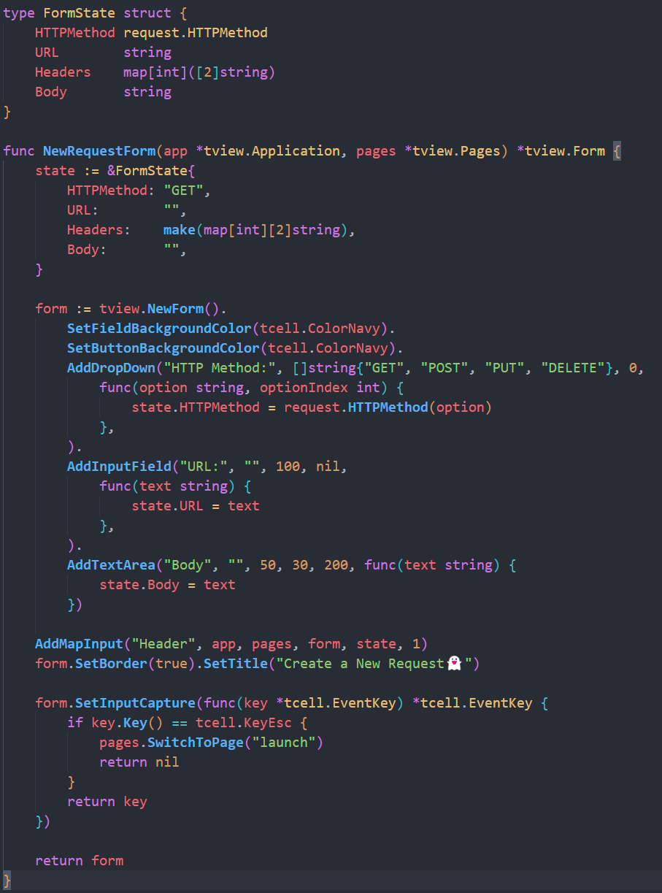
Making a new request form
Setting up form state here
Defining form attributes here
On ESC go back to home

Slide 22
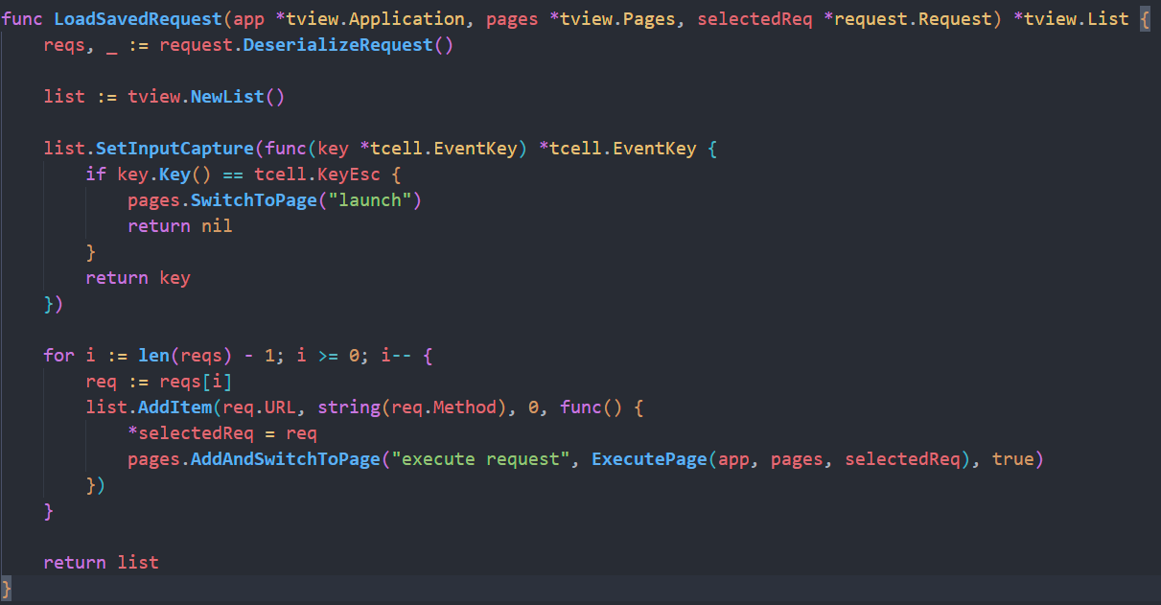
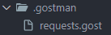
Picking from saved requests
Fetching requests from a .gost file
Populating list

Slide 23
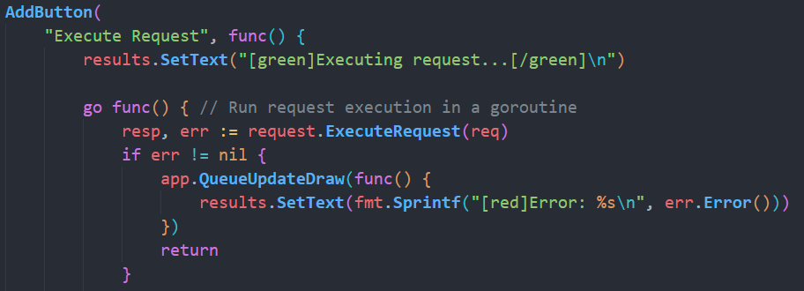
Executing request
In a goroutine so it doesn’t block the rest of the terminal!

Slide 24
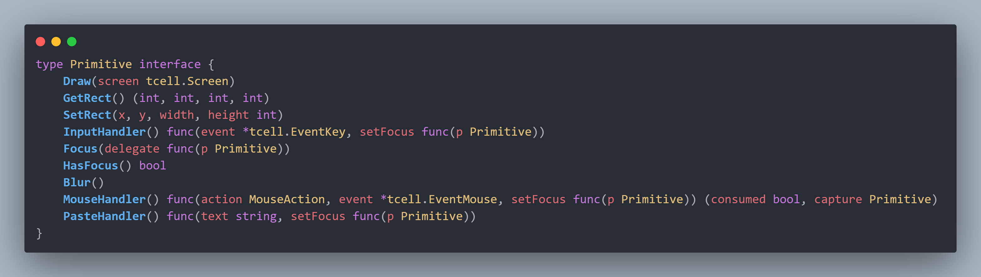
tview basics
Every rendered item is a primitive. tview only knows how to render primitives.

Slide 25
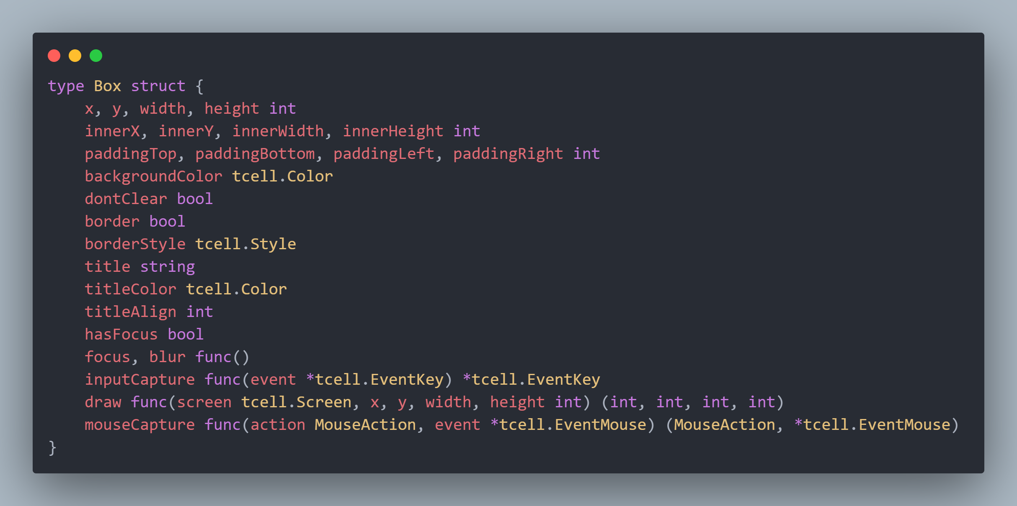
Box
The tview.Box struct implements tview.Primitive

Slide 26
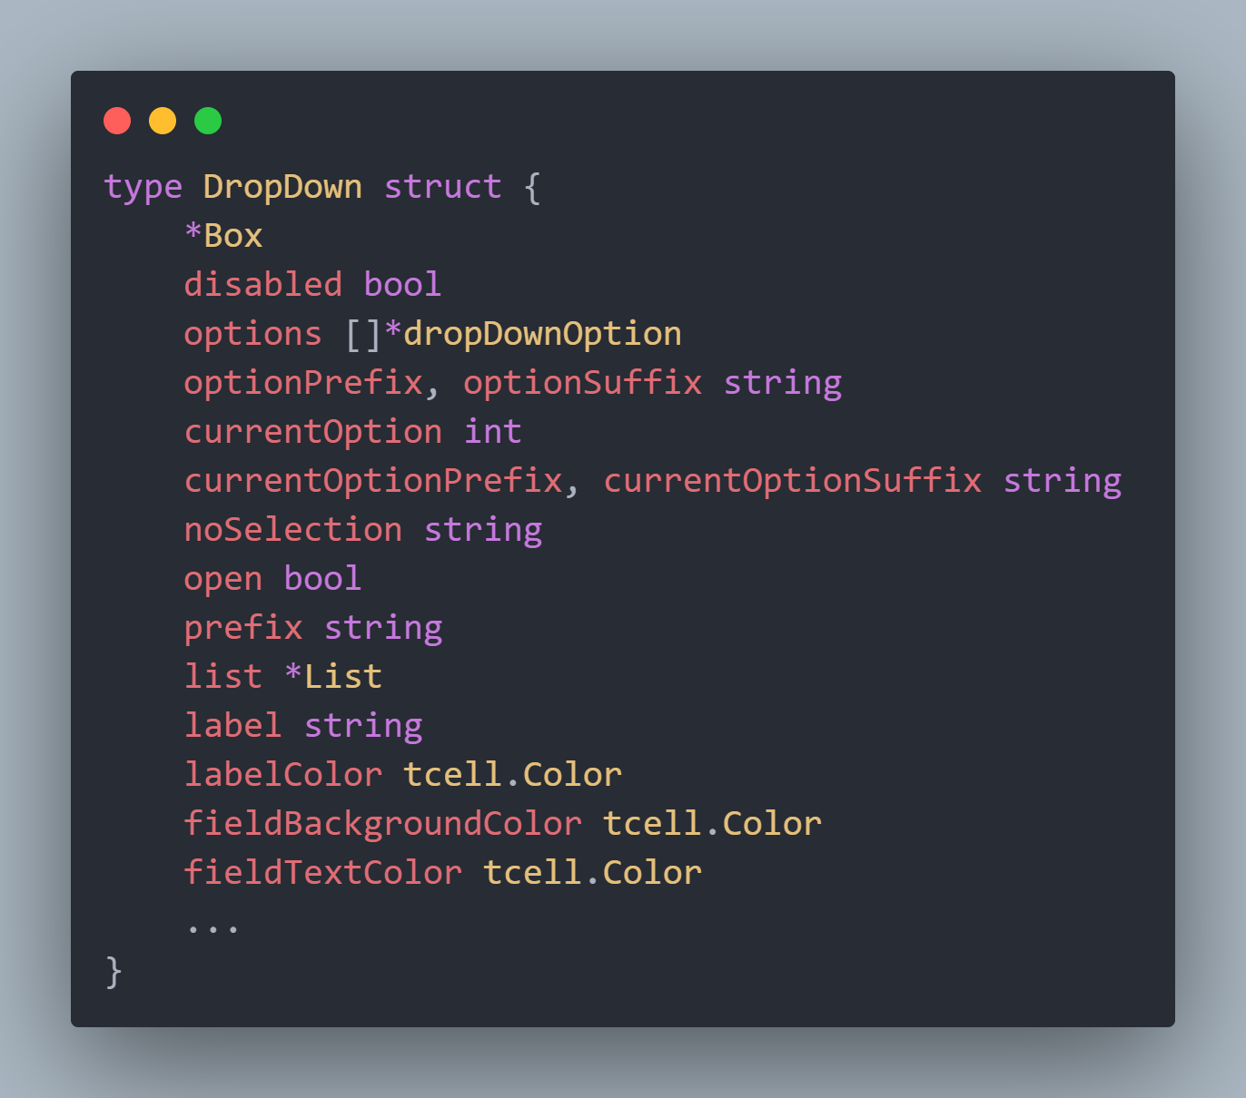
Most widgets just have a Box + extra logic
For example, here is the dropdown widget:

Slide 27
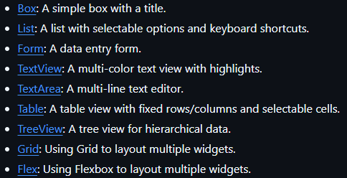
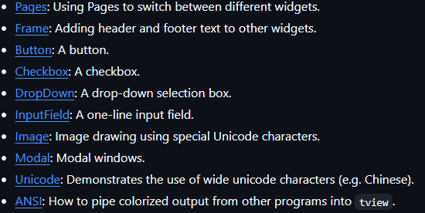
What else can tview do?
Lots. Here is a list of supported widgets (you can also make your own)
It also handles mouse interactions…

Slide 28
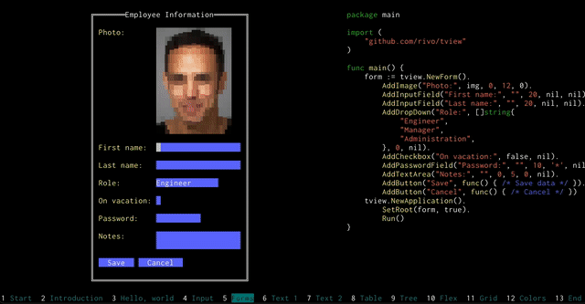
Better example of many pieces fitting together

Slide 29
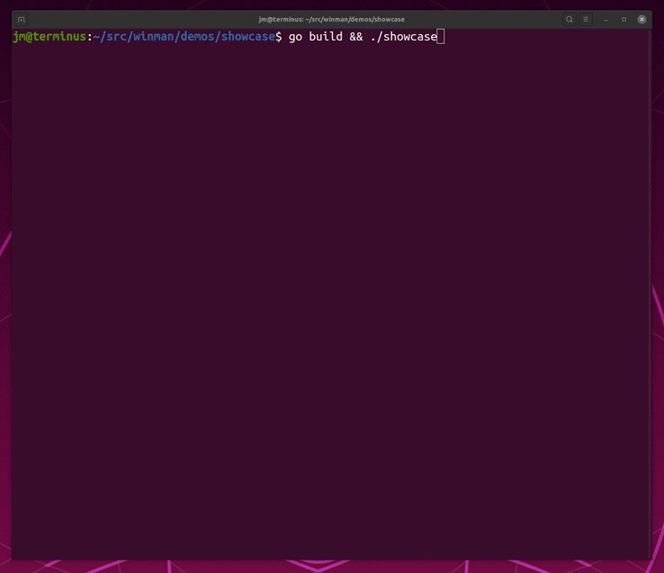
Someone even extended it to add windows

Slide 30
To review:
Terminal GUIs don’t have to suck (thanks tview)
Don’t write a GUI in a terminal unless you have to

